Slide 1
Digital Portfolio
STUDENT NAME:K.SANTHANALAKSHMI
REGISTER NO AND NMID: 24134060500122042 AND asanm40624134060500122042
DEPARTMENT: BCA(II YEAR)
COLLEGE: COLLEGE/ UNIVERSITY:DHARMAPURAM ADHINAM ARTS COLLEGE ,AFFILIATED ANNAMALAI UNIVERSITY

Slide 2
PROJECT TITLE
*Creative Student Portfolio Using FWD

Slide 3


AGENDA
Problem Statement
Project Overview
End Users
Tools and Technologies
Portfolio design and Layout
Features and Functionality
Results and Screenshots
Conclusion
Github Link
3/21/2024 Annual Review

Slide 4

PROBLEM STATEMENT
A digital portfolio provide an interactive and accessible platform tonperform achivements,skills and experience

Slide 5

PROJECT OVERVIEW
The aims to empower students and young leaders with the skills, knowledge and confidence to becomes innovation problem solved and change markers. the project focuses on developing leadership qualities,fostesting creativity and promoting social responsibilities

Slide 6

WHO ARE THE END USERS?
*students( projects,resumes) *Job seekers(career counseling) *young professionals(leadership skills)

Slide 7

TOOLS AND TECHNIQUES
#HTML-->Structure #CSS-->Styling #JS-->Interactivity

Slide 8
POTFOLIO DESIGN AND LAYOUT
*Home/About me *Project *Skills *Contact *Responsive layout
8

Slide 9
FEATURES AND FUNCTIONALITY
*Navigation bar-with smooth scrolling *Project showcase with image/details *Contact form( Valiclation) *Respondive design for all devices

Slide 10
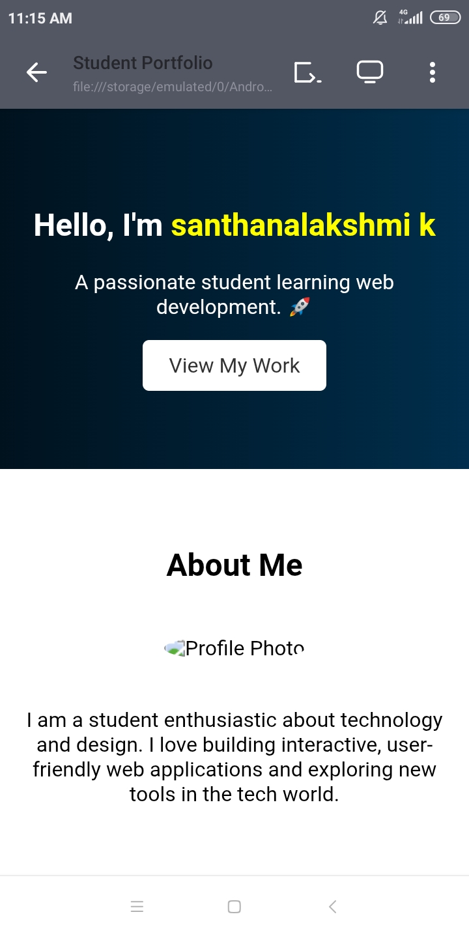

RESULTS AND SCREENSHOTS
3/21/2024 Annual Review
10

Slide 11
CONCLUSION
The project has been a resounding success,empowering students and young laeders with the,knowledge and confidence to become innovation problem-solvers and change makers
11

